Slide 1



trainity
HIRING
Process Analytics
SALMAN BAREESH

Slide 2



PROJECT DESCRIPTION
The task is to analyze the company's hiring process data and draw meaningful insights from it.
The hiring process is a crucial function of any company, and understanding trends such as the number of rejections, interviews, job types, and vacancies can provide valuable insights for the hiring department.
The insights could potentially help the company improve its hiring process and make better hiring decisions in the future

Slide 3





APPROACH
The data would need to be cleaned to remove any duplicate (or) irrelevant entries andensure that the data is properly formatted.
Check and identify the outliers and remove any outliers that may have significant impacton the analysis.
Perform relevant descriptive statistic calculations to gain a general understanding ofdataset.
Now extract the useful insights using statistical analysis and visualize the insights usingdata visualization methods.

Slide 4


TECH-STACK USED
MS Excel used to do statistical analysis
The reason I chose this language is because I have prior experience from my college

Slide 5

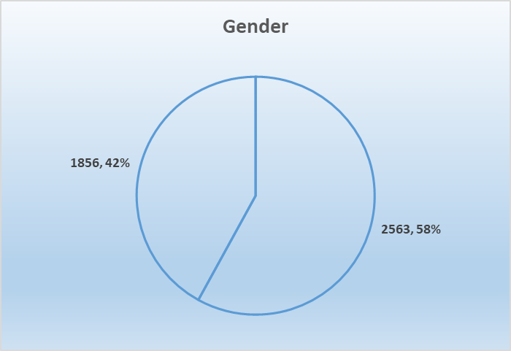
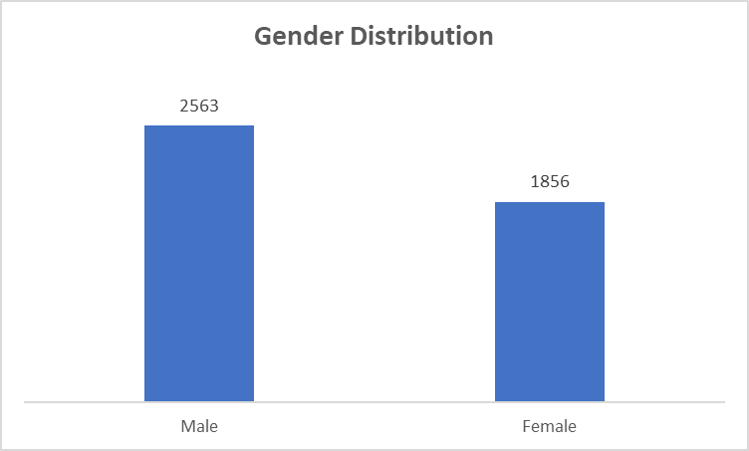


HIRING ANALYSIS

Slide 6
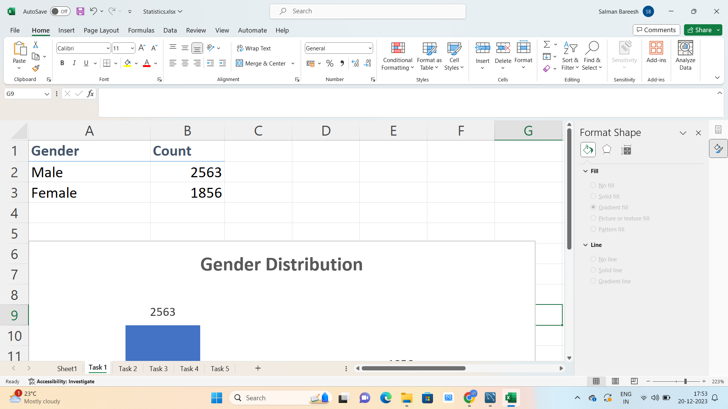
HIRING ANALYSIS
From the above bar and pie chart we can observe that there are total of 2563 males and 1856 females are hired for different positions in the company.

Slide 7

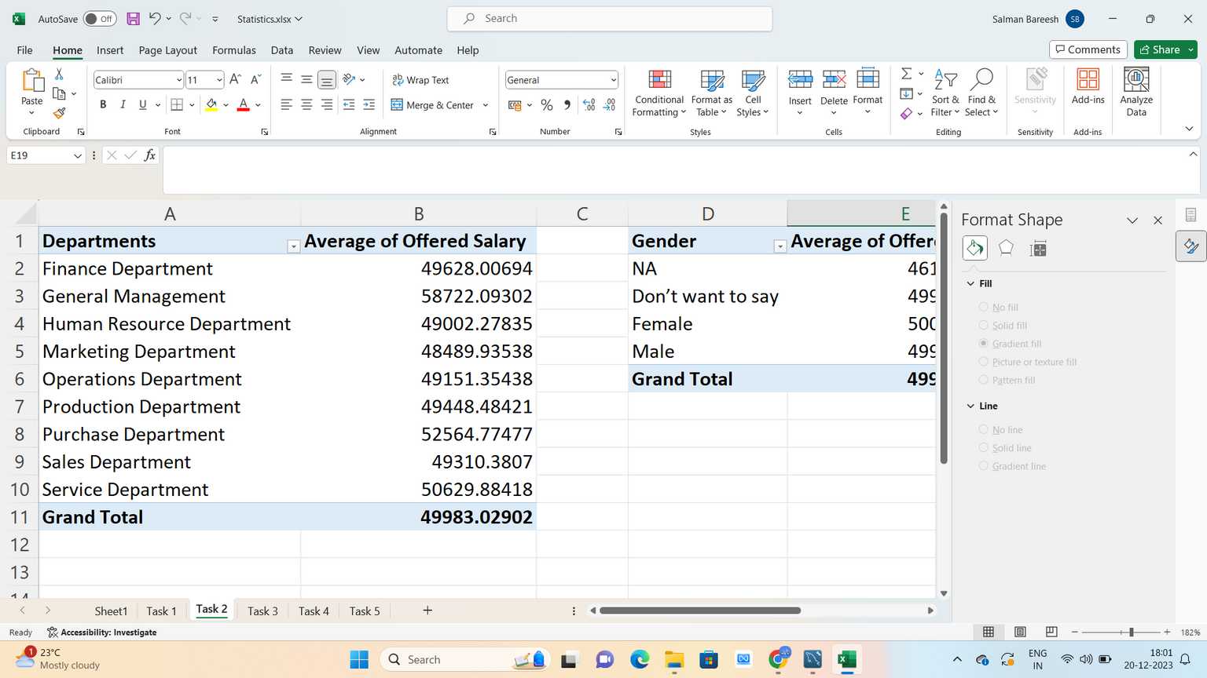
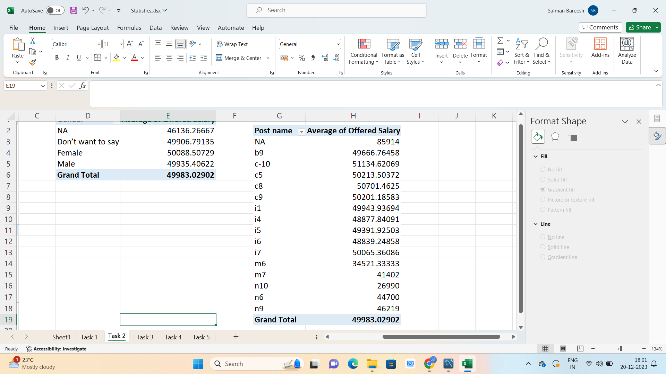
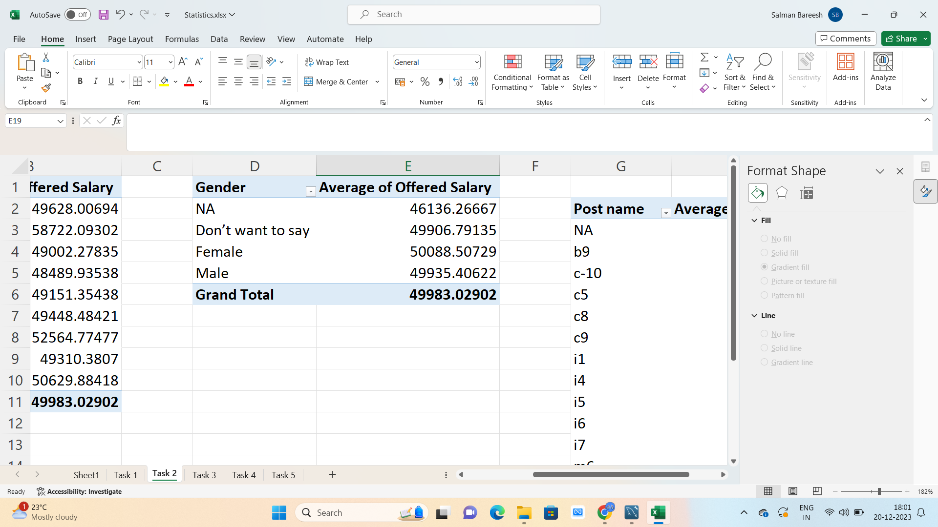
SALARY ANALYSIS
The average salary offered in this company is ` 49982.97 `

Slide 8

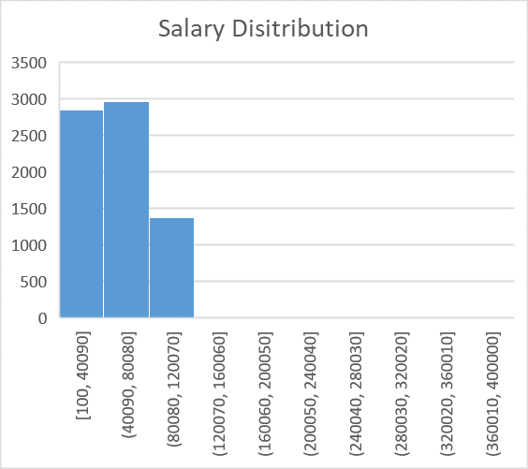
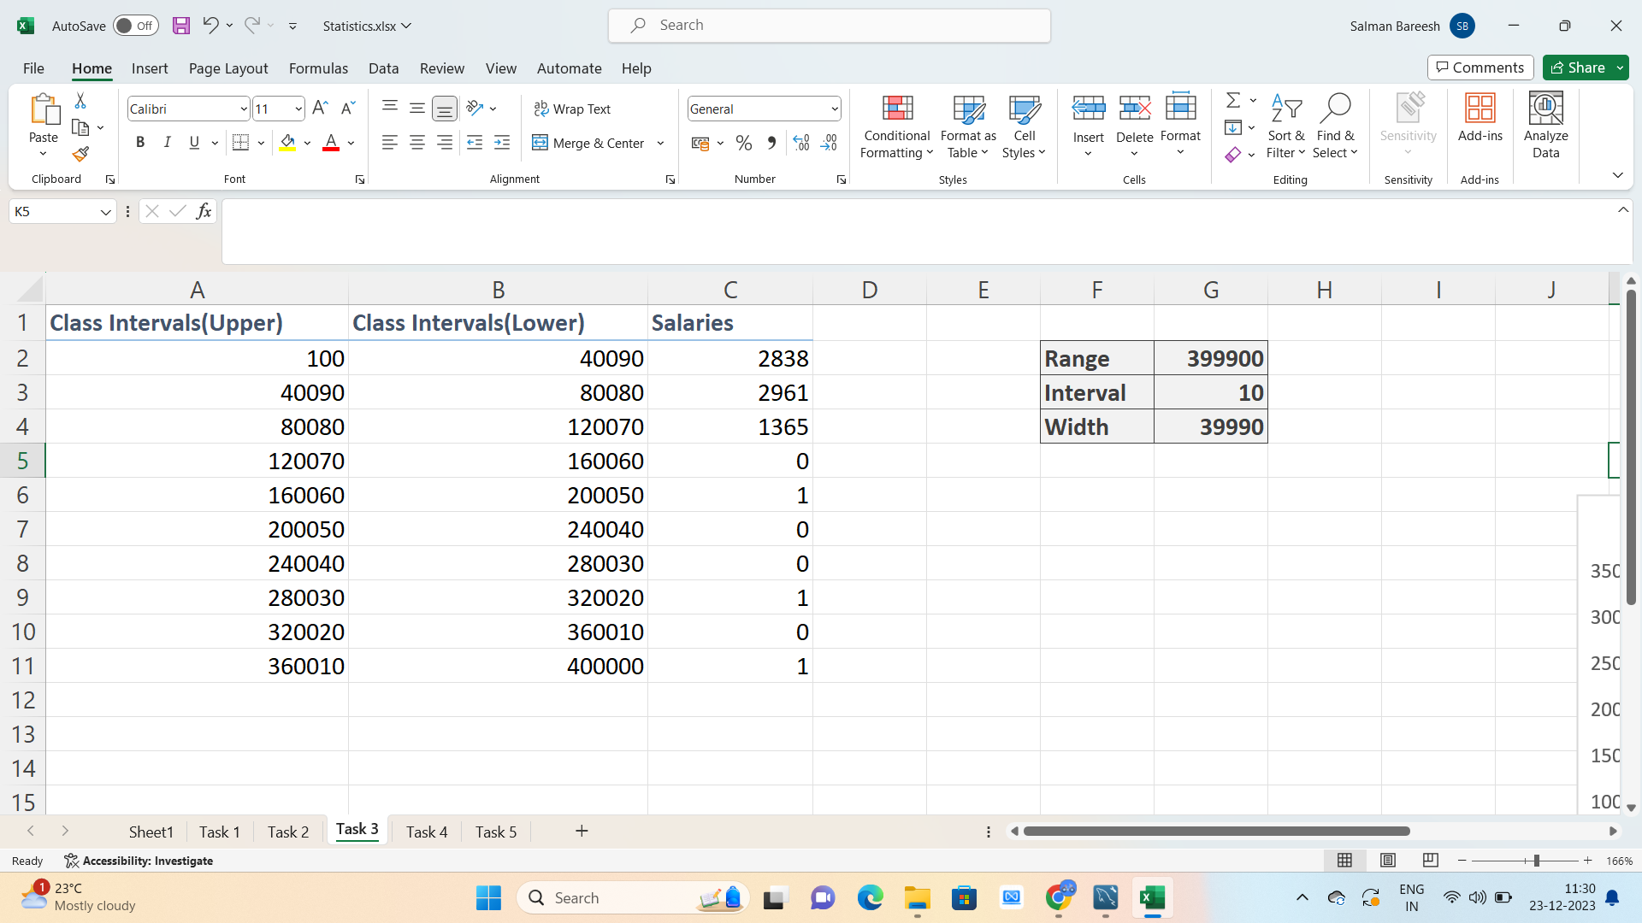
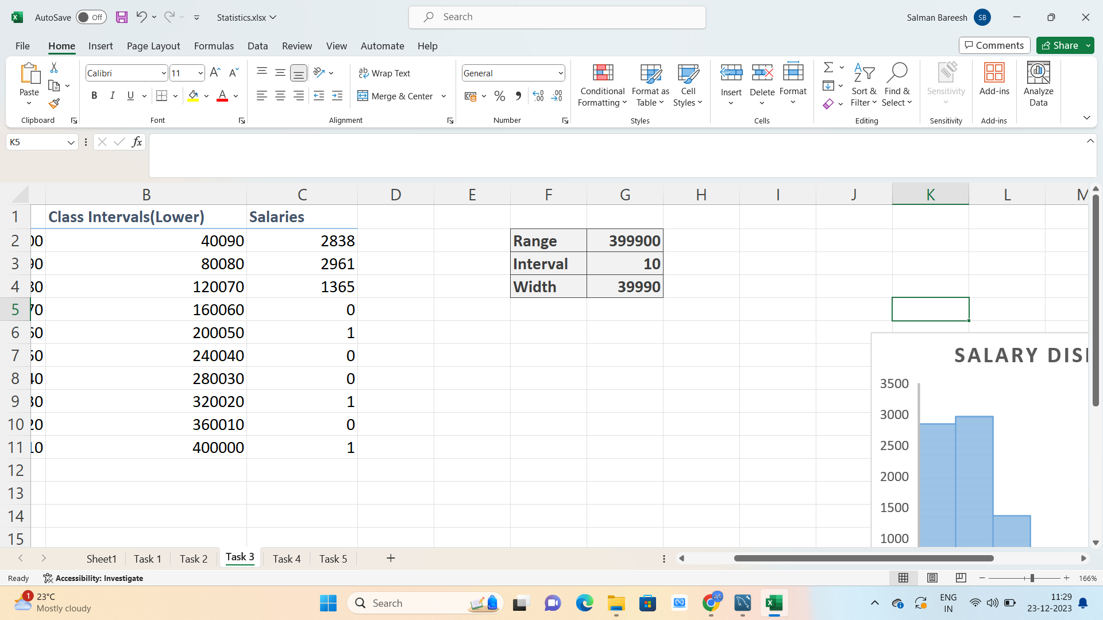
SALARY DISTRIBUTION
From the above data we can infer that salry range 40090-80080 is offered to the maximum number of people 2961

Slide 9

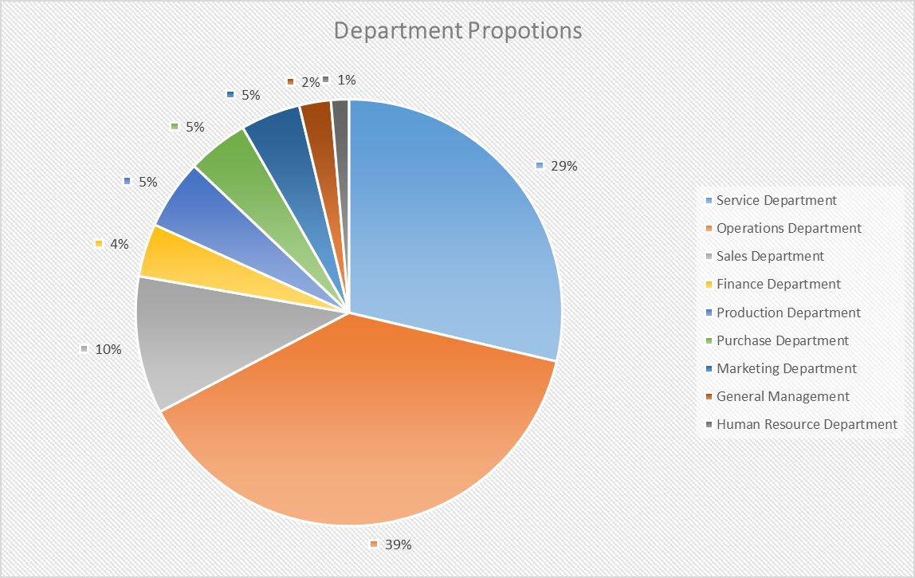
DEPARTMENTAL ANALYSIS

Slide 10
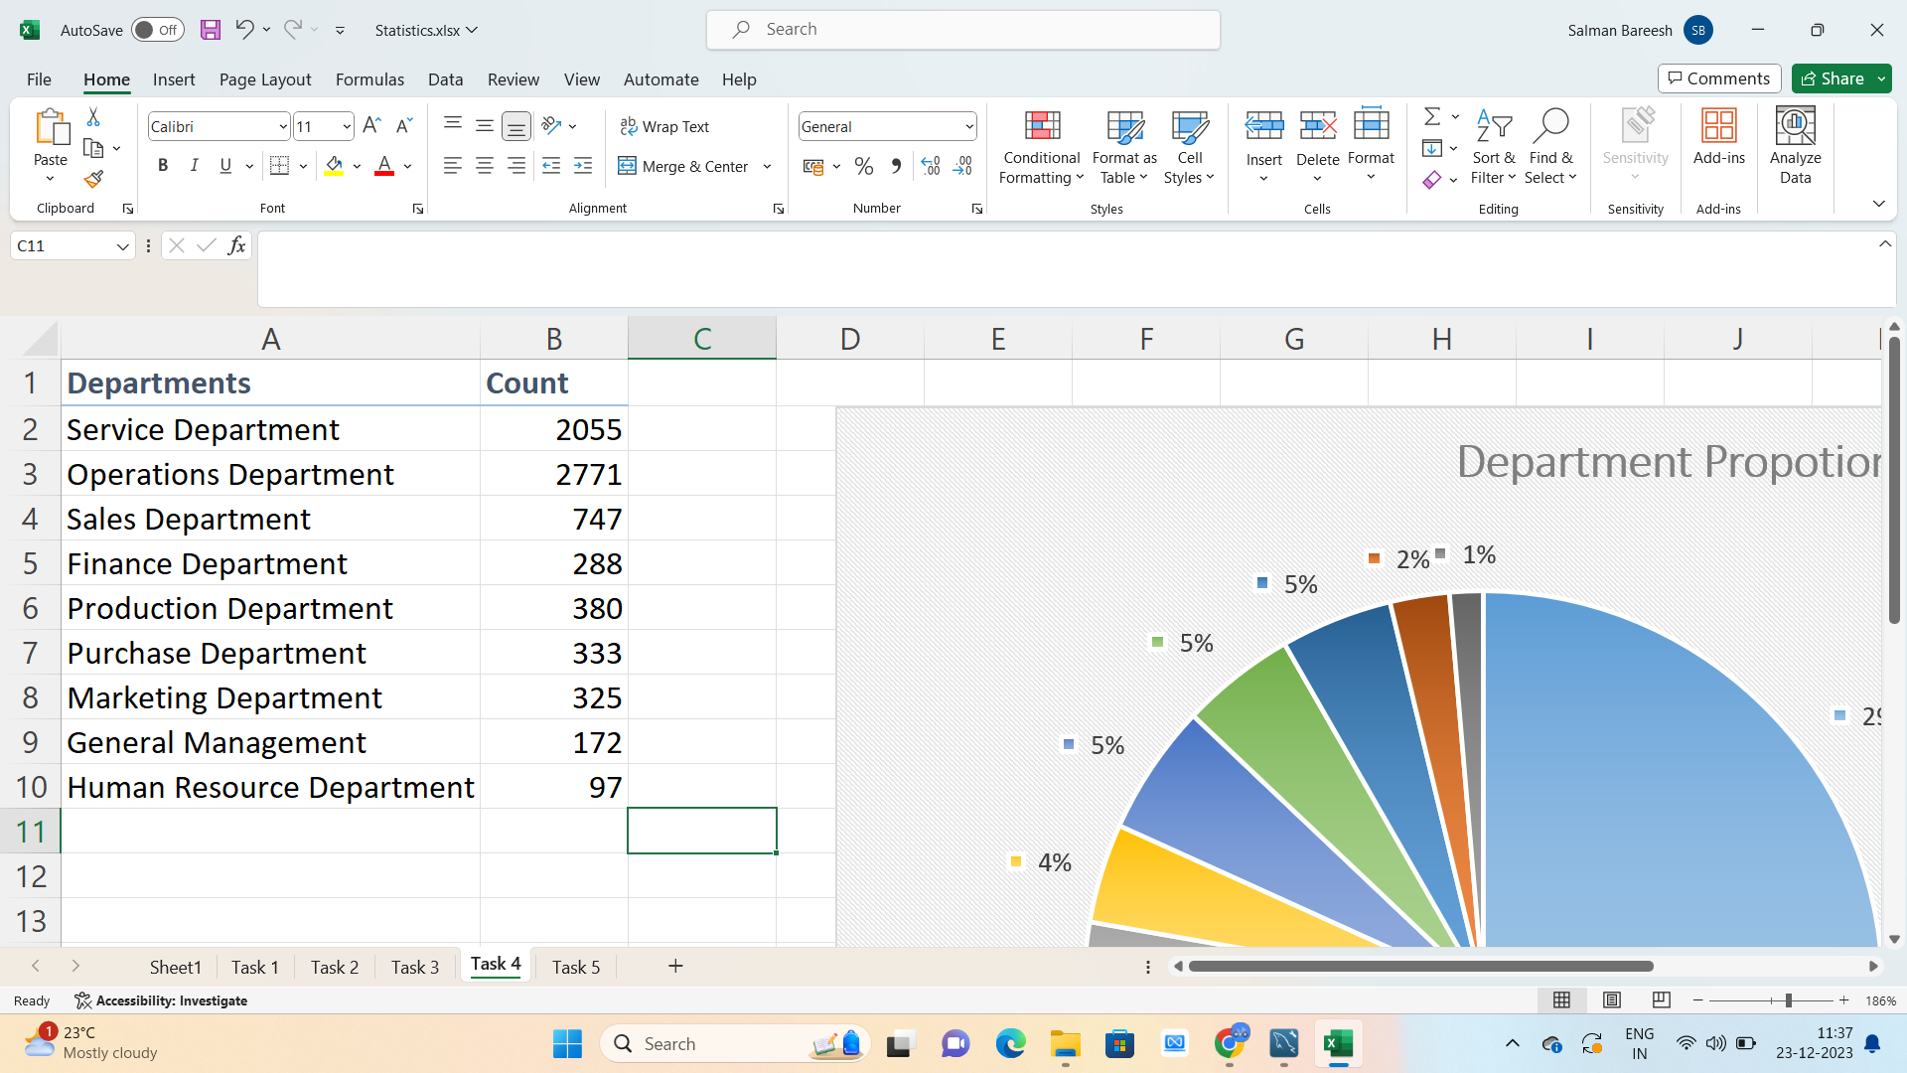
DEPARTMENTAL ANALYSIS
39% of hired people i.e, 1843 people are working in operations department.Whereas only 1% of hired people i.e, 70 people are working in Human Resource department.

Slide 11

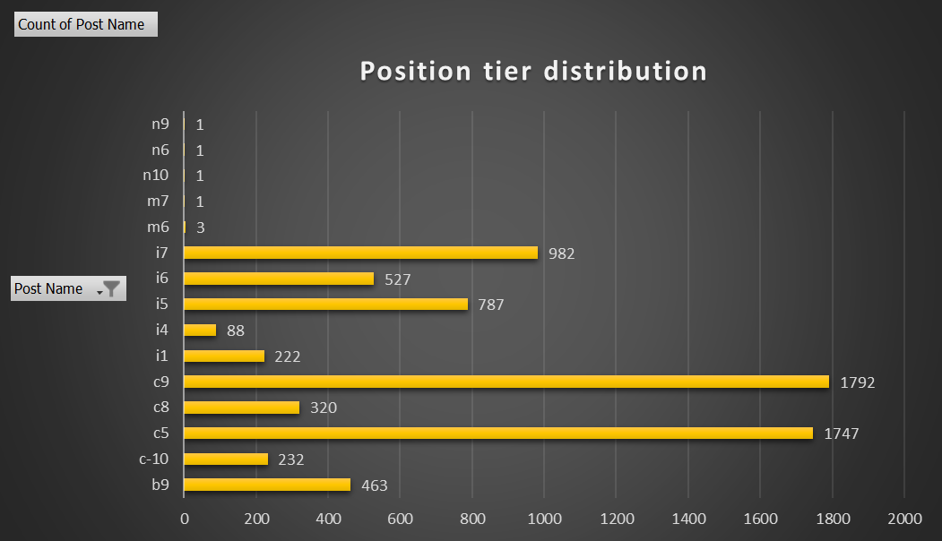
POSITION TIER ANALYSIS

Slide 12
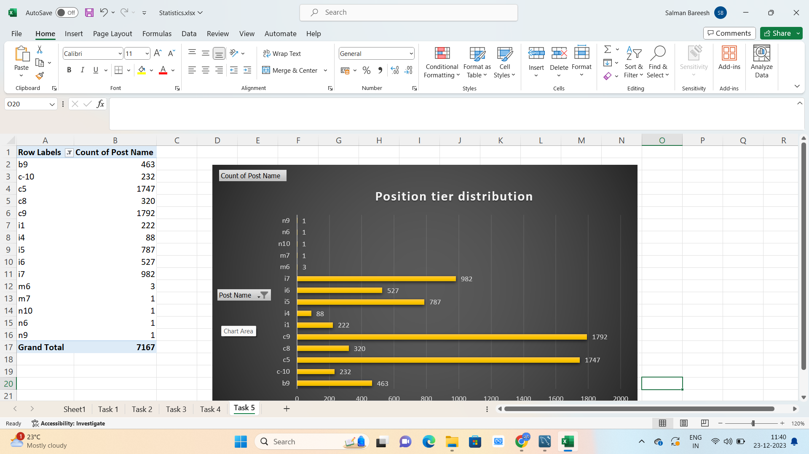
POSITION TIER ANALYSIS
From the bar chart and bar plot I have inferred that the most number of people
i.e,1792 are applied for the c9 post which accounts for 25% of total number of people
applied

Slide 13

RESULTS
I have done the analysis on the provided dataset / data as per the questions asked andmprovided the necessary insights and tried to plot the necessary charts / graphs as per requirement and my understanding.
This project is helped me in better understanding theprocess of Exploratory Data Analysis (EDA).
Click here for excel file with task solutions

Slide 14

trainity
THANK YOU

